Slide 1


Power BI Hackathon Organized by National Bank of Canada & Microsoft
Team 28
Raj Shekhar Mukherjee
Hasnain Ejaz
Arslan Ahmed
Syed Hassan Shaukat

Slide 2
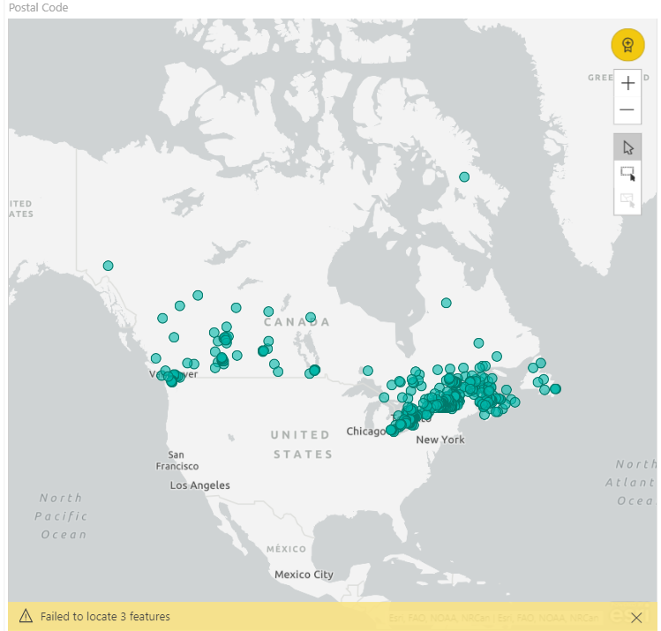
Mortgages by location

Slide 3
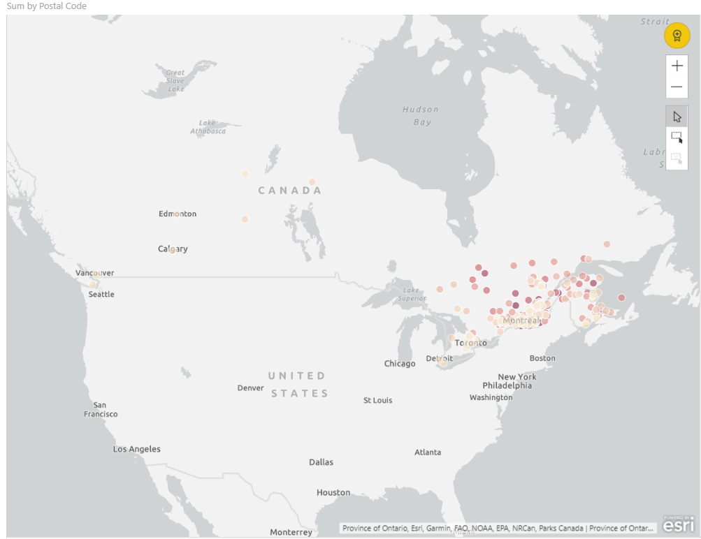
Penetration rate by location

Slide 4
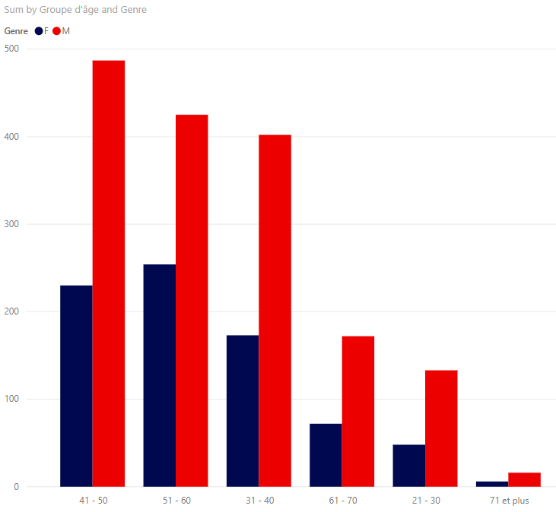
Insurances by gender

